Slide 1
Global Cert
The Six Clique

Slide 2
Problem Statement
Global Cert: (OI-GLCT-01)
Design a certificate generator that
Automatically maps the contents of a given certificate
Retrieves the data of the certificate holder from a file
Writes/prints the details accordingly at their intended location

Slide 3
Introduction
We have developed a python code to generate a certificate by reading .csv file and store the generated certificate in a specific folder
The name of the folder is the college’s name
In that folder, the certificate will be stored as .jpg file
The name of the .jpg file is the name of the participant
The generated certificate are sent to a particular participant, via mail. This is according to the participant’s email id in the .csv file
Auto Mailing System

Slide 4
The generated certificates are also stored in the Google firebase storage bucket for retrieving and referencing the data
The generated certificate is uploaded in the Google Firebase, according to the name of the name of the participant in .jpg format
Verification of the certificate by any organisation or authority
We have provided a unique QR Code for each certificate
When this QR Code is scanned, it redirects to a page on the website
This webpage will show whether the credentials are valid or not

Slide 5
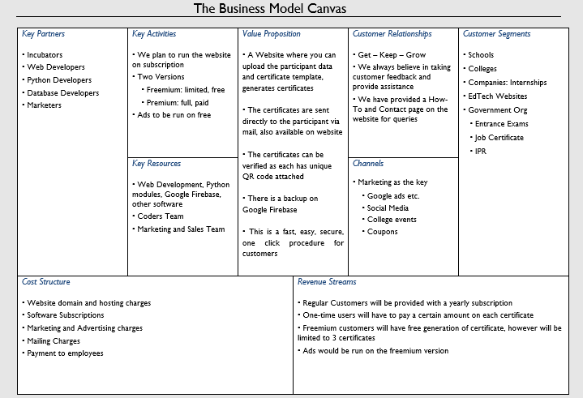

Slide 6
Generating Certificate
Why we are using .csv file
Generally, people use MS Excel for storing data in a systematic way
MS Excel is easy to use, visualise and modify
Thus, we will .xlsx to .csv file which is easy to read through python and create certificates
The naming of the folder are according to the college name, and in each folder, the .jpg file is named according to the participants
It is easy to access the list through the participant’s college name
As the .jpg file is named as the participant name, so its easy to identify participant’s certificate

Slide 7
Auto Generated Mail
It is better to mail the certificate to the participant
Don’t have to visit the website multiple times to retrieve the certificate, saves time
It gets stored in the mail cloud
Reduces the trafficking on the website
Thus, it is much more accessible and safer through mail

Slide 8
Google Firebase
We are using Google Firebase as a backup storage
This is in case the certificate gets deleted or lost from the system and/or mail
It is easier to use for the admin to refer the data as it is organised
Through Google Firebase we can access the certificate anywhere we want, such as on website, app, etc

Slide 9
Verification
We have added a feature of verification of certificates, just in case any organisation or authority wants proof of authenticity
We are planning to use unique QR code which is generated for each certificate for this purpose
This can be scanned and it will redirect to the webpage where the certificate credentials will be shown

Slide 10
